Slide 1



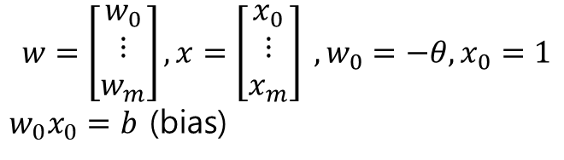



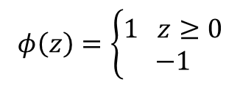
인공 뉴런 – 수학적 정의 : 출력
b (bias)
1
w0
Σ
$$φ\left(z\right)=\left\{\begin{aligned}1 z≥0 \\ −1\end{aligned}\right.$$
x1
w1
Φ
Out
$$φ(w^{T}x)$$
xn
wn
$$φ$$
1
$${+w}_{0}x_{0}$$
$$w=\left[\begin{matrix}w_{0} \\ ⋮ \\ w_{m}\end{matrix}\right],x=\left[\begin{matrix}x_{0} \\ ⋮ \\ x_{m}\end{matrix}\right] ,w_{0}=−θ, x_{0}=1$$
$w_{0}x_{0}=b$ (bias)
0
$$θ$$
$$w^{T}x$$
-1
$z=$ ${(w}_{0}x_{0}$)+$w_{1}x_{1}$+${…+w}_{m}x_{m}=w^{T}x$

Slide 2





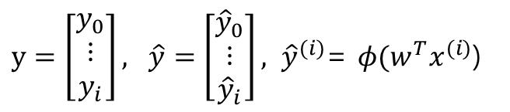
인공 뉴런 – 수학적 정의 : 학습
$$w_{j}:=w_{j}+∆w_{j} ,∆w_{j}= η\left(y^{(i)}+{\hat{y}}^{(i)}\right)x_{j}^{(i)}$$
b (bias)
$y=\left[\begin{matrix}y_{0} \\ ⋮ \\ y_{i}\end{matrix}\right], \hat{y}=\left[\begin{matrix}{\hat{y}}_{0} \\ ⋮ \\ {\hat{y}}_{i}\end{matrix}\right], {\hat{y}}^{(i)}$= $φ(w^{T}x^{(i)}$)
1
w0
Σ
x1
w1
Φ
Out
$$φ(w^{T}x)$$
xn
wn
$$φ$$
$$w=\left[\begin{matrix}w_{0} \\ ⋮ \\ w_{m}\end{matrix}\right],x=\left[\begin{matrix}x_{0} \\ ⋮ \\ x_{m}\end{matrix}\right] ,w_{0}=−θ, x_{0}=1$$
$w_{0}x_{0}=b$ (bias)
1
$$training$$
0
$$w^{T}x$$
$z=$ ${(w}_{0}x_{0}$)+$w_{1}x_{1}$+${…+w}_{m}x_{m}=w^{T}x$
-1

Slide 3
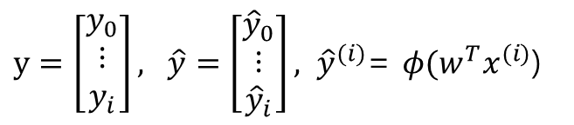
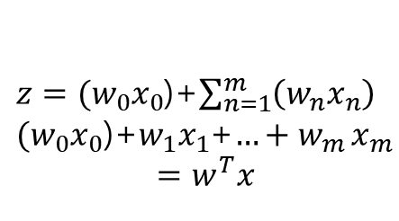

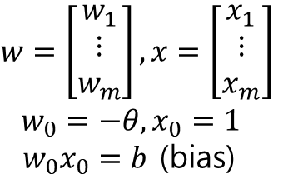



인공 뉴런 – 수학적 정의
$$w_{j}:=w_{j}+∆w_{j} ,∆w_{j}=∆w_{0}x_{j}^{(i)},∆w_{0}^{(i)}= η\left(y^{(i)}+{\hat{y}}^{(i)}\right)$$
b (bias)
오차
1
w0
Σ
$y=\left[\begin{matrix}y_{0} \\ ⋮ \\ y_{i}\end{matrix}\right], \hat{y}=\left[\begin{matrix}{\hat{y}}_{0} \\ ⋮ \\ {\hat{y}}_{i}\end{matrix}\right], {\hat{y}}^{(i)}$= $φ(w^{T}x^{(i)}$)
$w=\left[\begin{matrix}w_{1} \\ ⋮ \\ w_{m}\end{matrix}\right],x=\left[\begin{matrix}x_{1} \\ ⋮ \\ x_{m}\end{matrix}\right]$
$w_{0}=−θ, x_{0}=1$
$w_{0}x_{0}=b$ (bias)
x1
w1
Φ
Out
xn
wn
$z={(w}_{0}x_{0}$)+$\sum_{n=1}^{m}{\left(w_{n}x_{n}\right)}$
${(w}_{0}x_{0}$)+$w_{1}x_{1}$+${…+w}_{m}x_{m}$
$$=w^{T}x$$
$$φ(w^{T}x)$$
$$φ$$
1
$$training$$
0
$$w^{T}x$$
-1

